Slide 1
God always keeps his promises

Slide 2
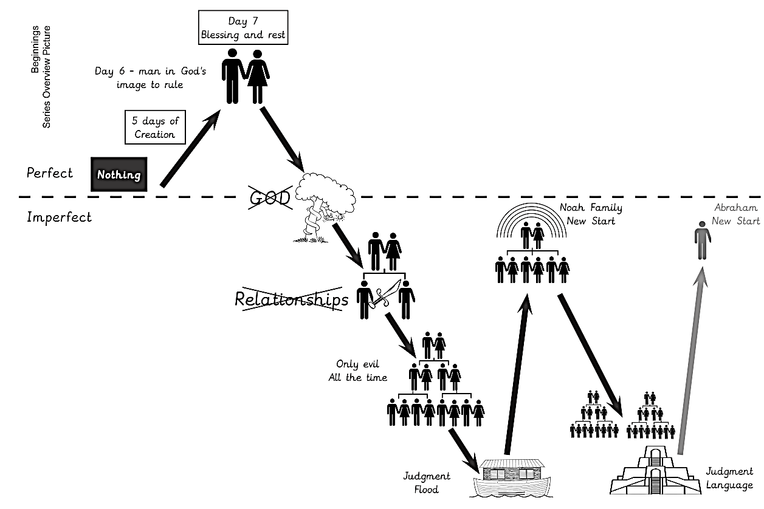

Slide 3
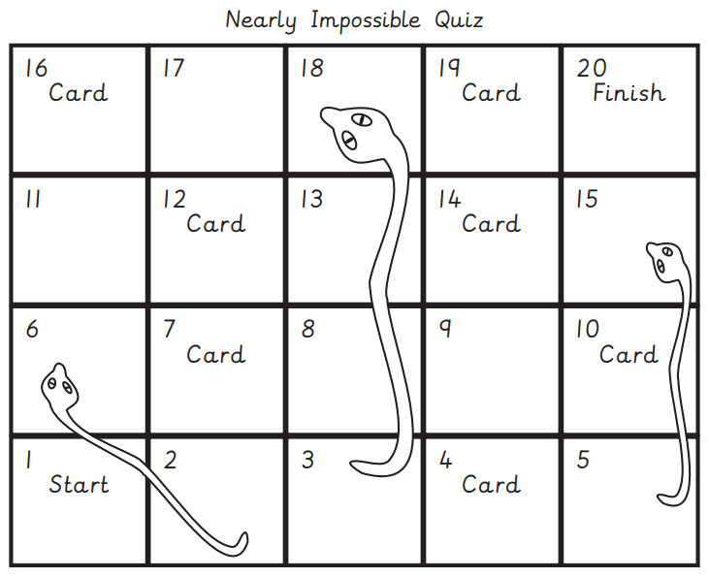

Slide 4
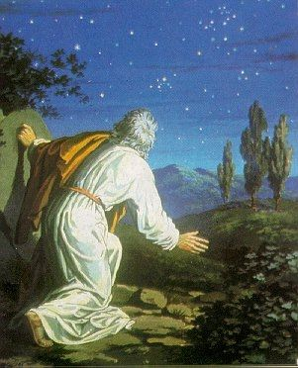

Slide 5
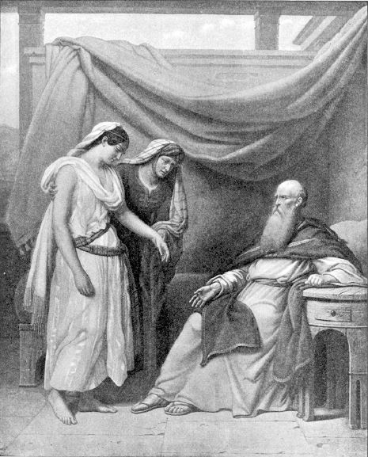

Slide 6
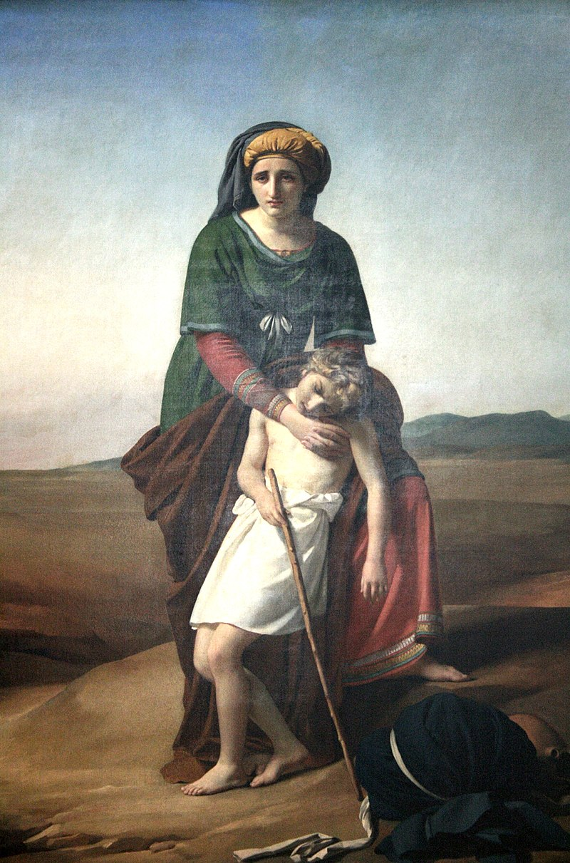

Slide 7
Today’s Lesson

Slide 8
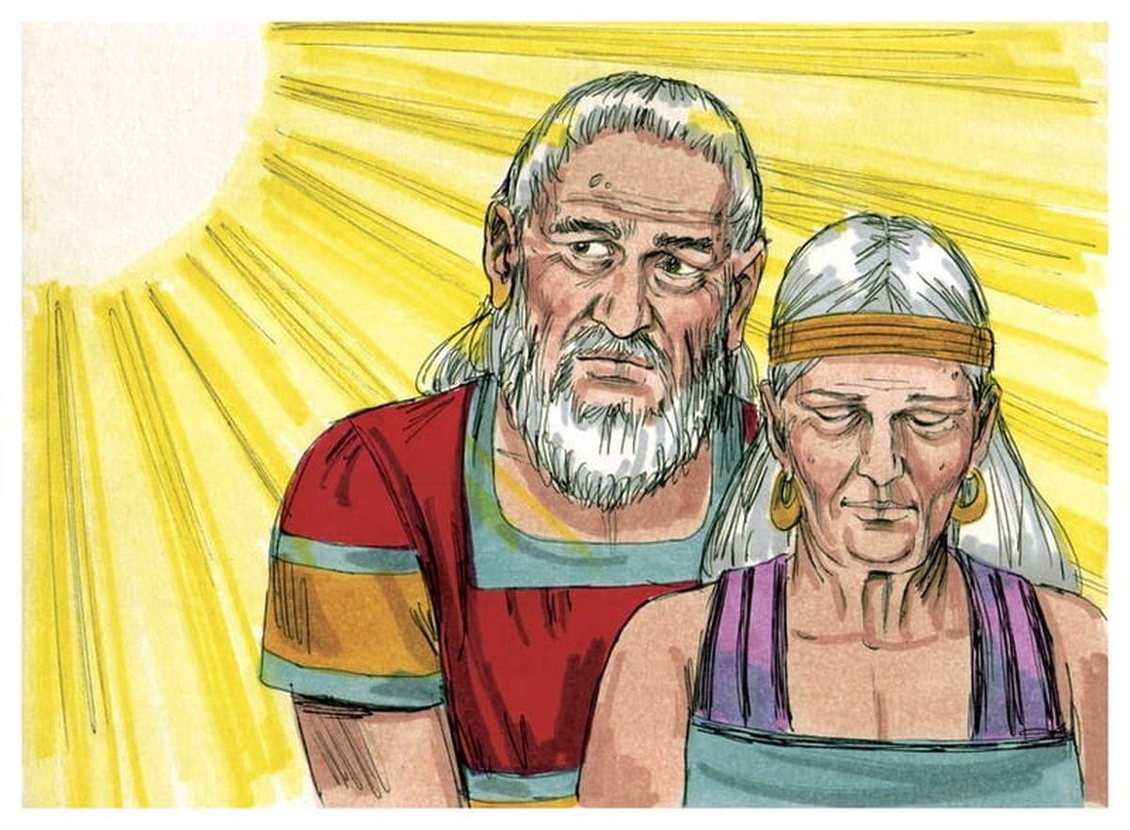

Slide 9
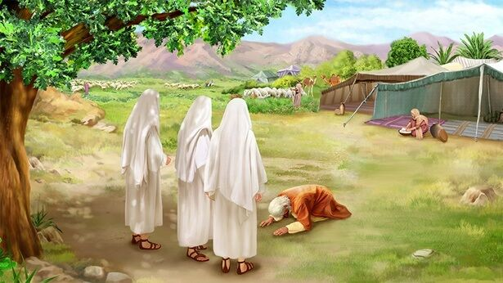

Slide 10
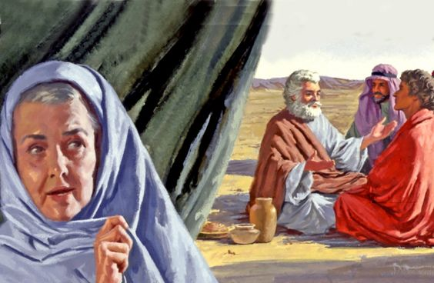

Slide 11
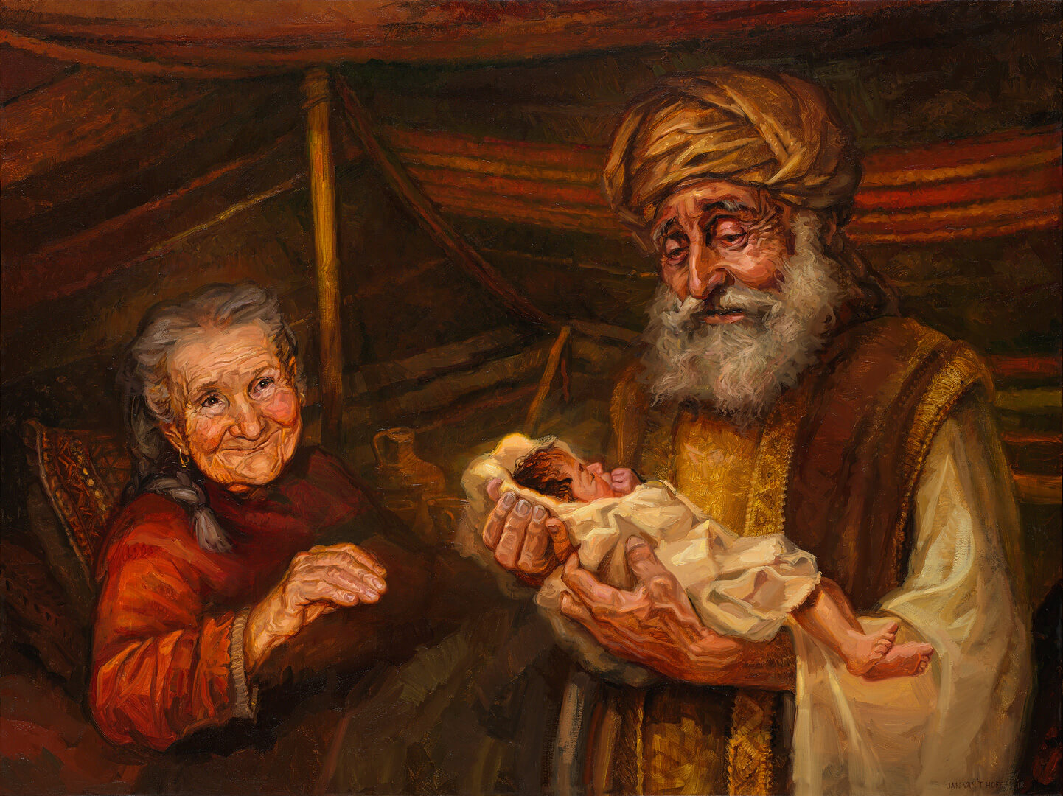

Slide 12
Scenarios

Slide 13
Tommy’s story
Tommy is in P6 this year. Tommy usually goes to church to worship the Lord. But his exams are next week.
Tommy usually does ok in school, but he is afraid that he won’t get into the high school he wants.
So he is wondering whether to skip church so he can attend extra tuition on Sunday morning.
Tommy calls you on Saturday night. What would you say to him a why?

Slide 14
Vanessa’s story
Vanessa comes from a poor family. Her parents have to work and don’t have time to help her with her homework.
Vanessa does quite badly at school, although she does try to learn.
Vanessa’s friend Tess somehow got the answers to the exam on Monday morning. Tess asked Vanessa go over to her house so she can get the answers.
Just as she is leaving her house, Vanessa bumps into you and tells you what is happening. What would you say to her? Should she or should she not?

Slide 15
God's work, done in God's way, in God's time, will produce God's rewards.

